Slide 1
Web Application Development II
Week 10: Testing
10b: Component & Integration Testing using Vitest

Slide 2
Agenda
Learning Outcomes
By the end of this lesson, you will know:
Component test is a "unit test" where a component is tested in isolation
(optional) We use stubs to represent a child component when necessary to test a parent component
What we want to include in a test to make it robust (not fragile): Robust tests should focus on behavior of the component, rather than the implementation.
The difference between integration testing & component testing
You can write & run a component test and integration test for Vue components using Vitest
Definitions and Concepts
Unit Testing: Functions
Component & Integration Testing
E2E Testing

Slide 3
Different Types of Tests
Let's start with component tests
In our context of Web apps written using Vue, a Vue component can be considered a "unit". So we will consider component testing a form of "unit testing". Component tests are usually performed by the developer who writes the component.
Test Type | What is Tested? | Components Involved | Goal
Unit Test | A single unit (e.g., a function, method, or class) | One component in isolation | Verify that an individual unit works correctly.
Integration Test | The interaction between multiple units or modules | Two or more integrated components | Verify that the components work correctly together.
End-to-End (E2E) Test | The complete system from the user's perspective | Entire application, including databases, APIs, and UI | Verify that complete user workflows function correctly.

Slide 4
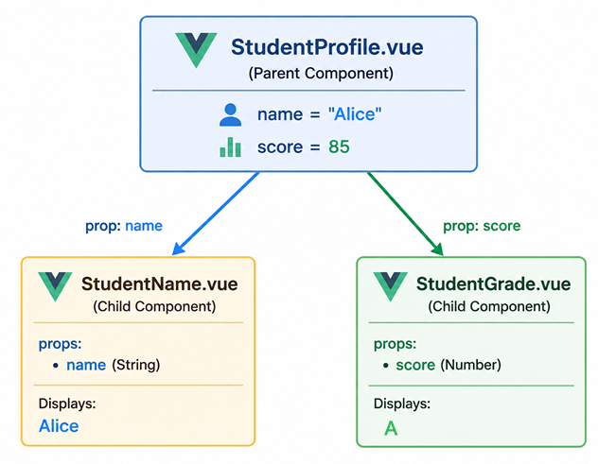
Context
StudentGrade.vue (child) & StudentName.vue (child) are independent components used by StudentProfile.vue (parent).
Study the code for these 3 components. StudentProfile communicates with StudentName & StudentGrade using props.
Component | Responsibilities
StudentProfile | • Receives the name and score props • Passes the name prop to StudentName • Passes the score prop to StudentGrade • Coordinates the display of the two child components
StudentName | • Receives the name prop • Displays the student's name
StudentGrade | • Receives the score prop • Computes the corresponding letter grade (A, B, C, or F) • Computes the text colour (green for pass, red for fail) • Displays the letter grade with the appropriate colour
We will be testing StudentGrade first, followed by StudentProfile.

Slide 5
Component Test -- StudentGrade
Let's focus on testing only StudentGrade. In a component test, we want to ensure that the component works correctly in isolation. We send over the score as a prop directly to StudentGrade. StudentProfile is never used in this test. Study StudentGrade.spec.js which contains 5 tests (You will write the 6th one).
What is being tested:
Business logic: the computed property correctly converts a numeric score into a letter grade
Presentation: the rendered HTML displays the correct letter grade, and the text color changes according to the grade
Test cases:
Test | Input | Expected Output | Purpose
(1) Displays grade A when score is 85 | 85 | Grade: A | Tests A boundary range
(2) Displays grade B when score is 75 | 75 | Grade: B | Tests B range
(3) Displays grade C when score is 65 | Grade: C | Tests C range
(4) Displays grade F when score is 45 | Grade: F | Tests failing grade
(5) Uses green text for passing grades | 85 | style contains green | Tests computed colour
(6) Uses red text for failing grades | 45 | style contains red | Tests computed colour
Notes:
Not tested in this example (but can be included):
boundary values (80, 79, 70, 69, 60, 59)
invalid input (negative numbers, undefined, strings, etc.)

Slide 6
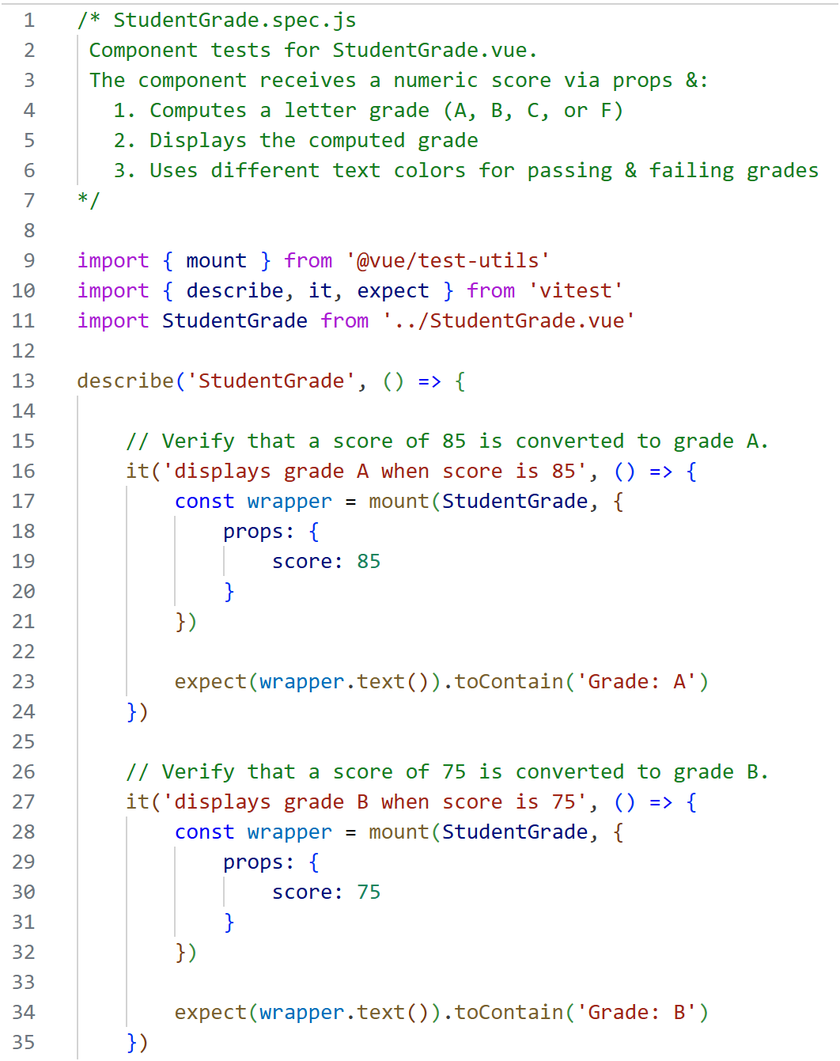
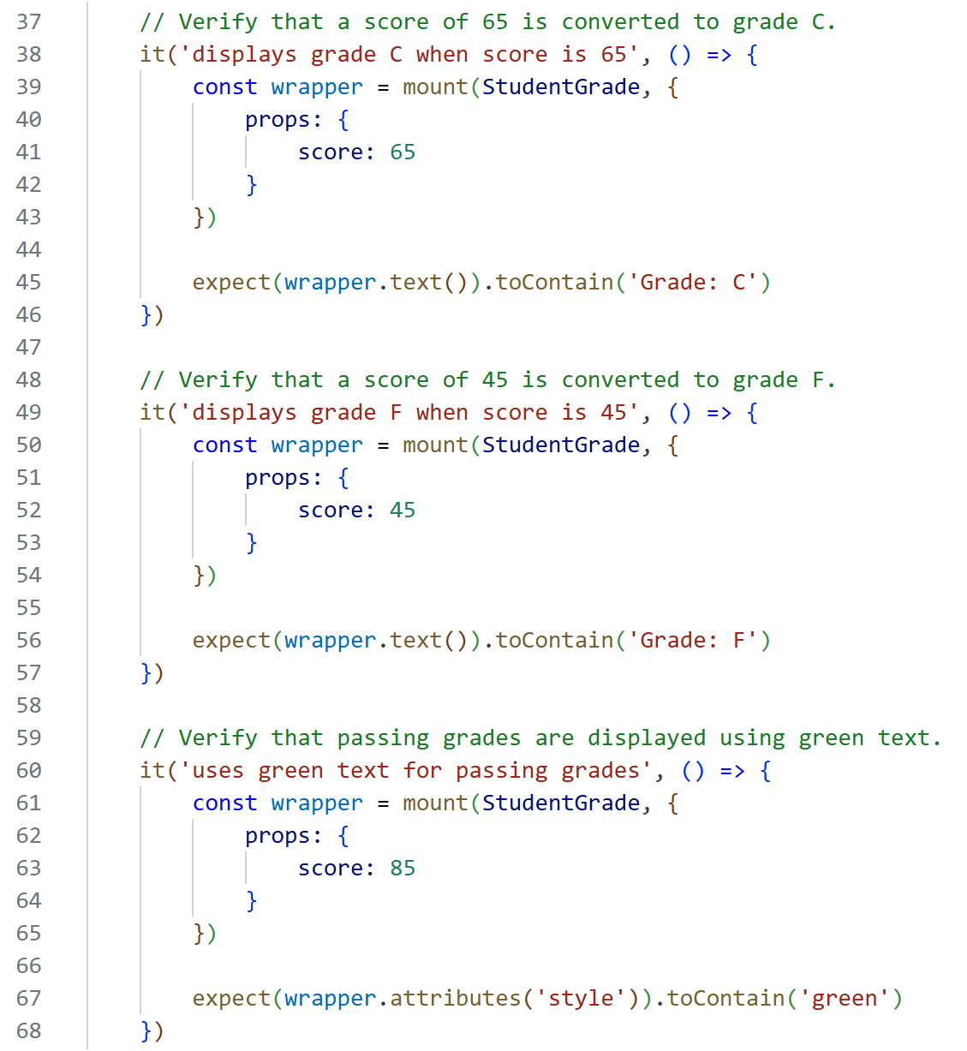
Component Test: StudentGrade
test3
StudentGrade.spec.js contains functions to test the StudentGrade component.
test4
test1
test5
test2

Slide 7
(optional) Component Test: StudentProfile
Now let's focus on testing only StudentProfile. Study StudentProfile.spec.js which contains 5 tests.
The 1st four tests focus on prop passing. The 5th test is an integration check within the parent component, confirming that both child components are rendered together and each receives the correct prop. It demonstrates that StudentProfile correctly coordinates its children as a whole.
Test | Input | Expected Output | Purpose
(1) passes the correct name to StudentName | name = "Alice", score = 85 | Stub renders Name: Alice | Verifies that StudentProfile passes the correct name prop to the StudentName child component.
(2) passes the correct score to StudentGrade | name = "Alice", score = 85 | Stub renders Score: 85 | Verifies that StudentProfile passes the correct score prop to the StudentGrade child component.
(3) passes a different name to StudentName | name = "Bob", score = 85 | Stub renders Name: Bob | Verifies that changing the name prop results in the updated value being passed to StudentName.
(4) passes a different score to StudentGrade | name = "Alice", score = 75 | Stub renders Score: 75 | Verifies that changing the score prop results in the updated value being passed to StudentGrade.
(5) renders both child components | name = "Alice", score = 85 | Stub renders both Name: Alice and Score: 85 | Verifies that StudentProfile renders both child components and passes the correct props to each simultaneously.

Slide 8
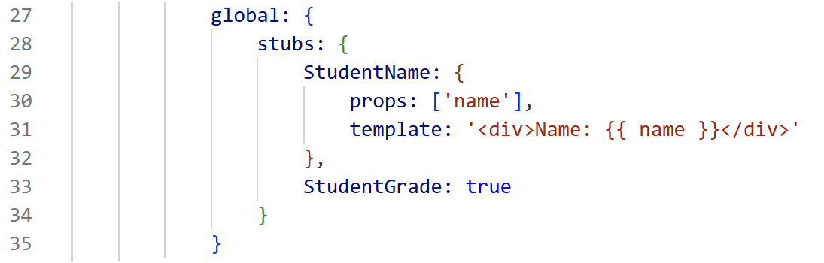
(optional) Component Test: StudentProfile
StudentGrade and StudentName are not used in this test. A stub is used when the component under test contains child components that you want to replace with lightweight "fake" components. Here, StudentGrade & StudentName are replaced with stubs.
StudentProfile.spec.js: 1st test
In the 1st test:
StudentName is a custom stub. It accepts the name prop and displays it, allowing you to verify that StudentProfile passes the correct prop.
StudentGrade: true is an automatic stub. Vue Test Utils replaces it with a placeholder component because you don't need it for this test.

Slide 9
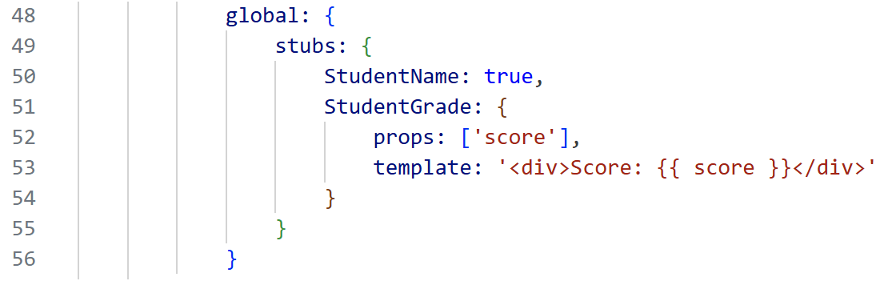
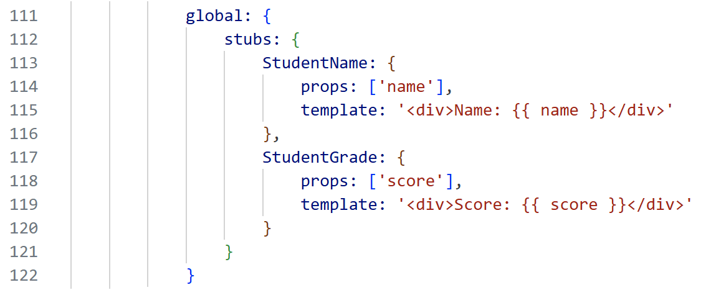
(optional) Component Test: StudentProfile
StudentProfile.spec.js: 2nd test
In the 2nd test:
StudentName is automatically stubbed
StudentGrade is a custom stub that echoes the score prop
StudentProfile.spec.js: 5th test
In the 5th test:
Both StudentName & StudentGrade are custom stubs. This lets you verify that both child components are rendered & receive the correct props.
By creating custom stubs that render the received props, you're testing exactly what StudentProfile is responsible for: passing the correct props to its child components, without executing the real child components' logic.

Slide 10
What to Test in a Component Test
Goal of component testing is not to test everything, but to test the component's behavior & contract.
Ask "If this feature breaks, would a user or another developer care?".
If yes, then maybe this behavior is worth testing
Examples of what is usually worth testing:
Props: does the component render correctly when props change?
Conditional rendering: different states display correctly
User interactions: clicks, typing, selections
Emitted events: are the correct events emitted?
Computed values
Different states
Focus on:
Important links & buttons: correct URLs & actions
Business logic that matters to users
Examples of what is usually not worth testing:
Every HTML tag
Every CSS class
Exact HTML structure
Framework functionality

Slide 11
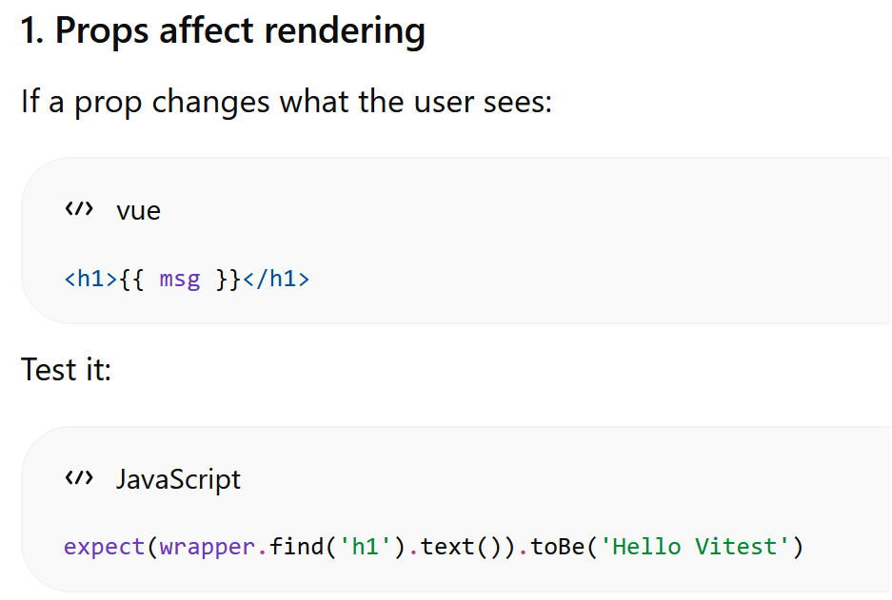
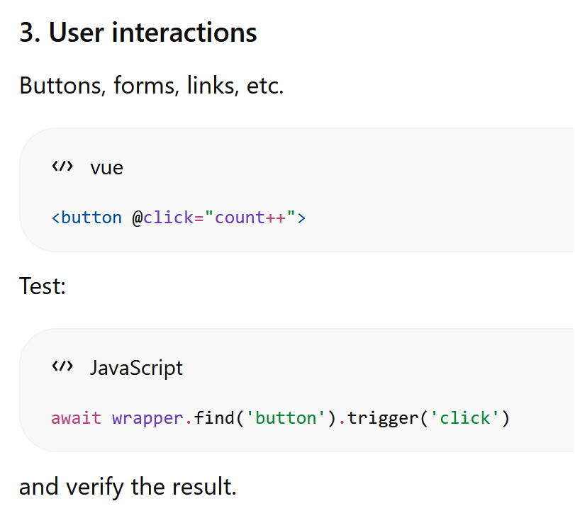
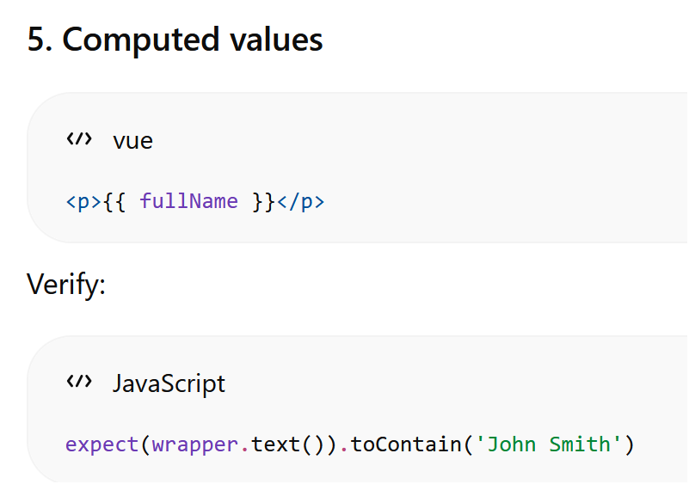
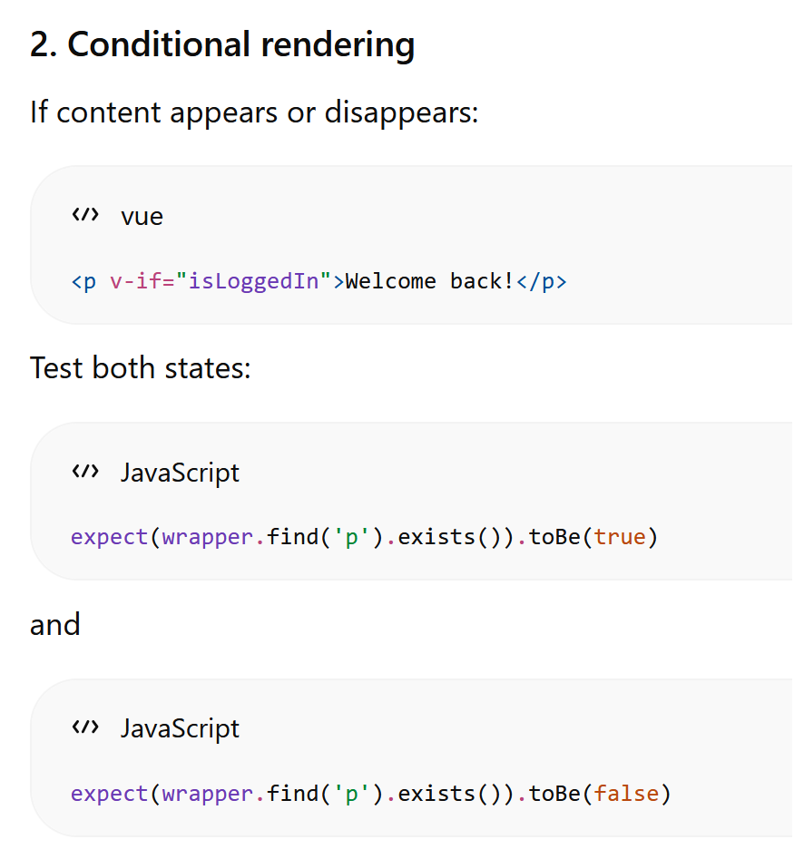
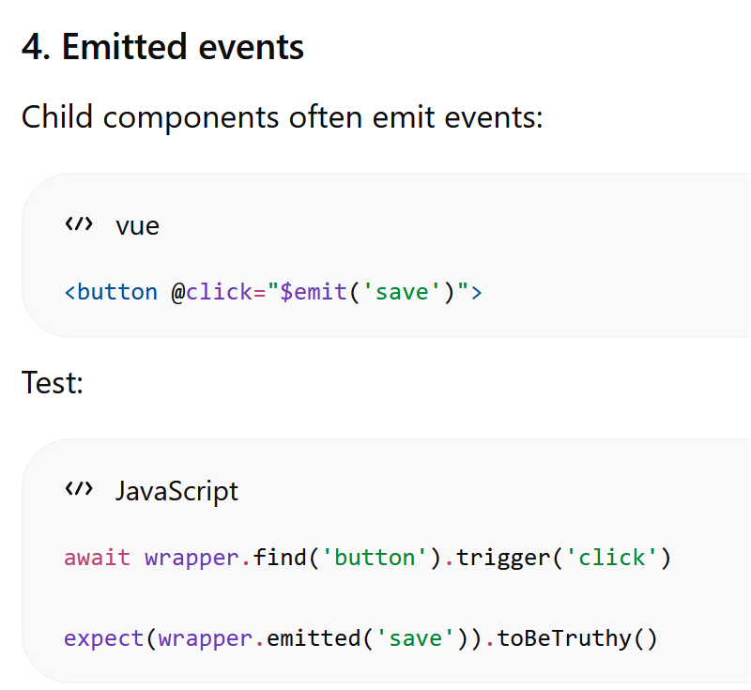
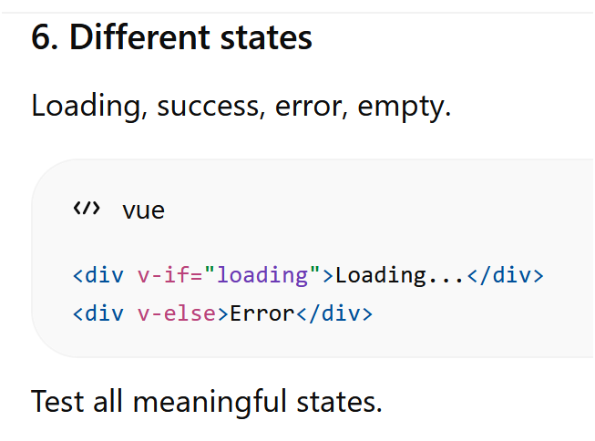
Examples of what is usually worth testing:

Slide 12
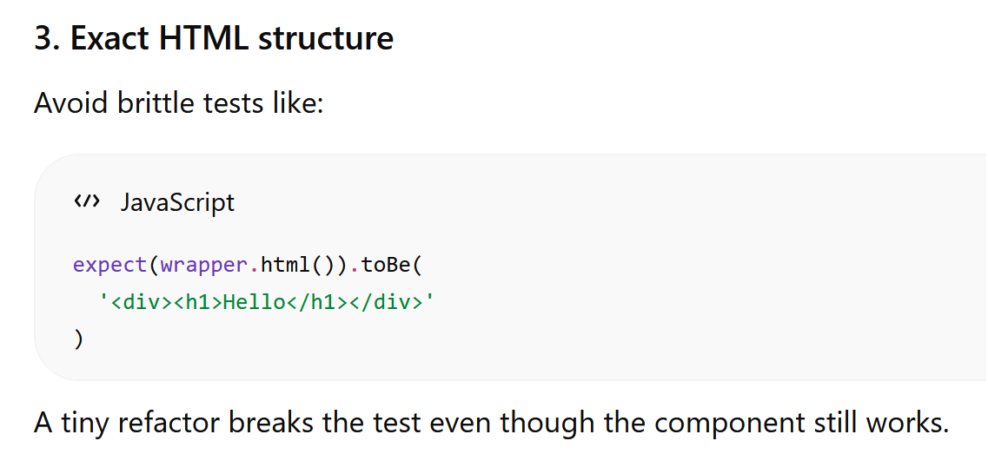
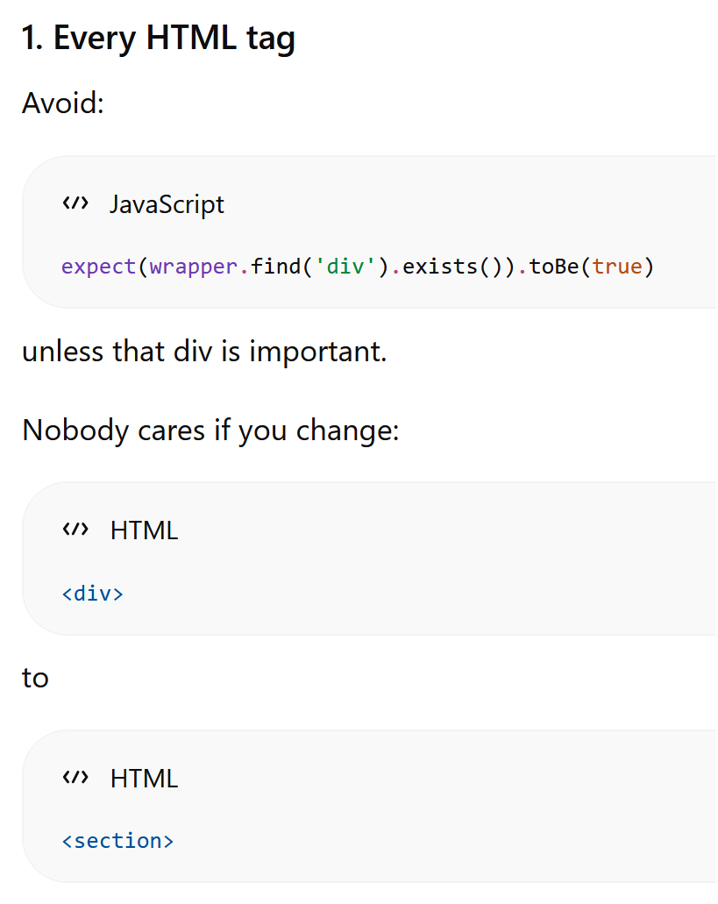
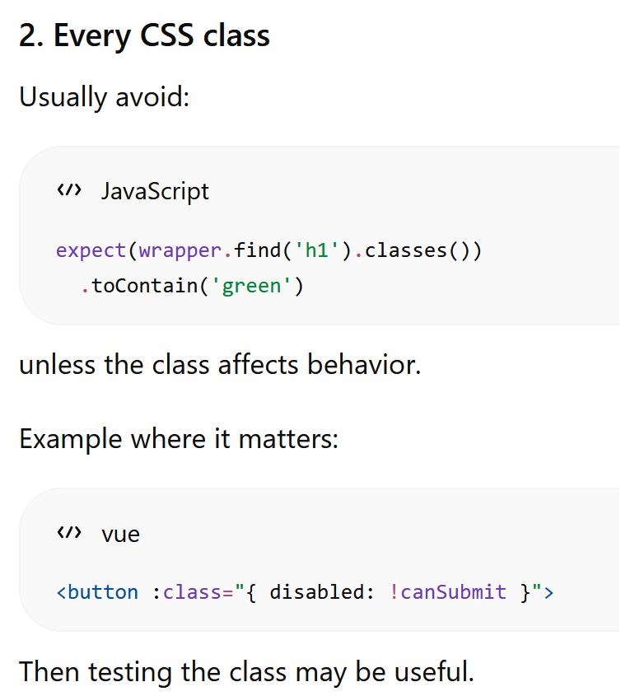
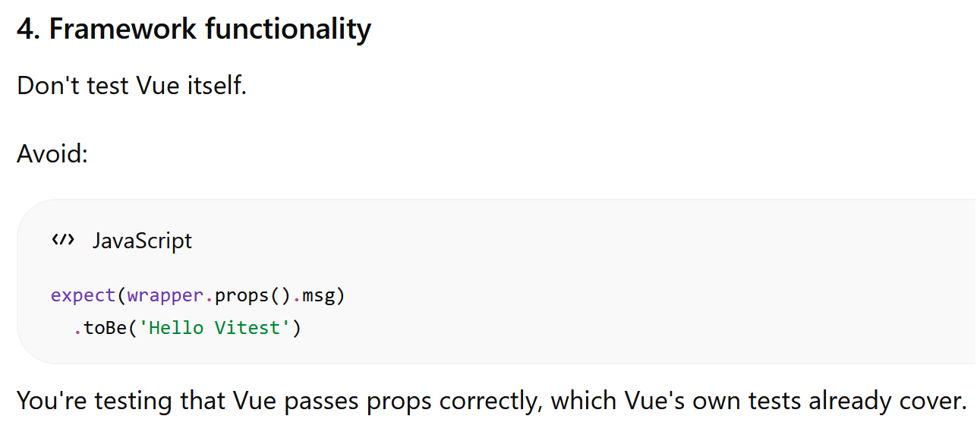
Examples of what is usually not worth testing:

Slide 13
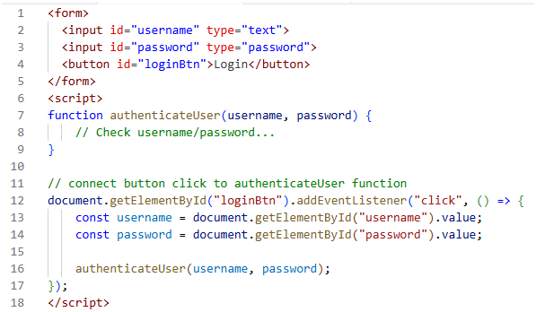
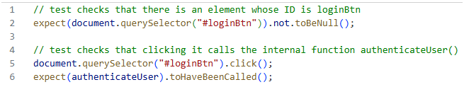
Fragile vs Robust Tests
Don't write fragile tests that provide little benefit. A fragile test is one that fails even though the software is still working correctly. Fragile tests are too sensitive to changes that should not matter.
E.g.:
Login page:
Fragile tests often:
Fail after harmless code refactoring.
Depend on implementation details instead of externally observable behaviour.
Require frequent updates even when the software still works correctly.
Discourage developers from improving or refactoring code because many unrelated tests break.
Robust tests:
Verify what the software does, not how it does it.
Continue to pass after internal refactoring.
Fail only when the observable behaviour changes unexpectedly.
Test:
This test is tightly coupled to the implementation of the login page

Slide 14
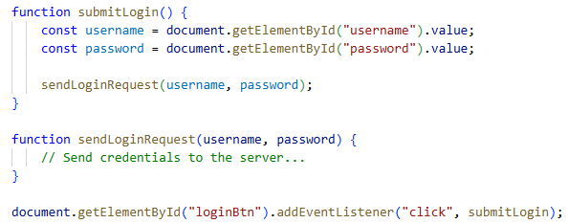
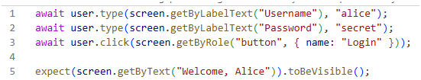
Fragile vs Robust Tests
Later if a developer refactors the page so that there is no more authenticateUser function:
The test will fail even though there is nothing inherently wrong with the app.
Similarly the test fails if the developer changes the ID of the button.
Instead of checking which function was called, a robust test checks what the user experiences.
This test doesn't care whether the app uses a particular function or any other implemention. It only verifies the behavior: can the user successfully log in?
Test:
Rule of Thumb: "Test behaviour, not implementation."

Slide 15
Different Types of Tests
Let's move on to integration tests
When we test 2 or more components interacting with each other, we consider that an "integration test".
Test Type | What is Tested? | Components Involved | Goal
Unit Test | A single unit (e.g., a function, method, or class) | One component in isolation | Verify that an individual unit works correctly.
Integration Test | The interaction between multiple units or modules | Two or more integrated components | Verify that the components work correctly together.
End-to-End (E2E) Test | The complete system from the user's perspective | Entire application, including databases, APIs, and UI | Verify that complete user workflows function correctly.

Slide 16
Integration Test
Unlike the component tests, now we will mount the real StudentProfile, StudentName & StudentGrade components together to verify that they collaborate correctly. Study the code for IntegrationTest.spec.js which contains 3 tests. (You will write the 4th one).
Test cases:
Test | Input | Expected Output | Purpose
(1) Displays A for score 85 | name = "Alice", score = 85 | Displays Alice and Grade: A | Verifies that StudentProfile passes the props correctly, StudentName displays the name, and StudentGrade computes and displays grade A.
(2) Displays B for score 75 | name = "Bob", score = 75 | Displays Bob and Grade: B | Verifies that all 3 components work together correctly for a student with grade B.
(3) Displays C for score 65 | name = "Charlie", score = 65 | Displays Charlie and Grade: C | Verifies that all 3 components work together correctly for a student with grade C.
(4) Displays F for score 45 | name = "David", score = 45 | Displays David and Grade: F | Verifies that all 3 components work together correctly for a student with grade F.
The integration tests intentionally do not verify the text colour of the letter grade, since that responsibility has already been covered by StudentGrade's component tests.

Slide 17
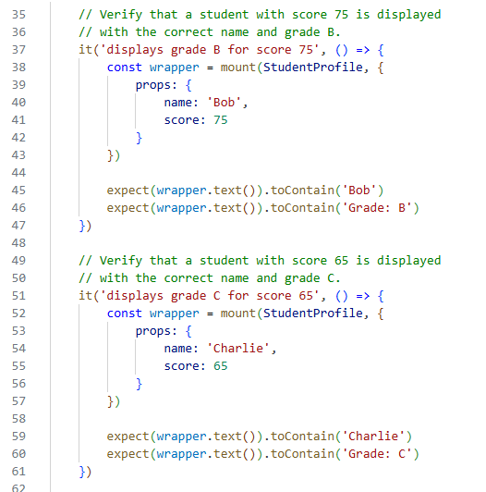
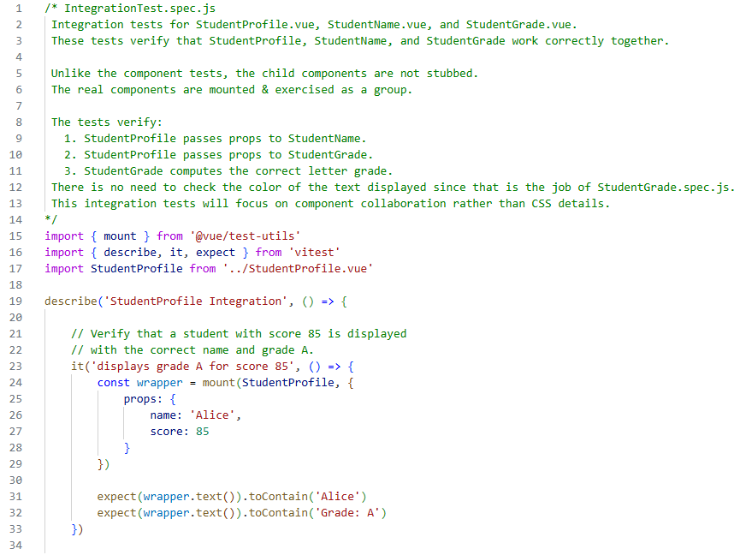
Integration Test
IntegrationTest.spec.js checks that the 3 components work correctly together

Slide 18
Setting Up for Ex 2 (1)
Host Ex2. This is a Vue app containing 3 components (StudentProfile, StudentGrade & StudentName).
In this exercise, we will start with component tests:
Test StudentGrade in isolation.
Test StudentProfile.
(we will not test StudentName in this exercise since we already have StudentGrade as an example)
We will continue with an integration test:
Test all 3 components together

Slide 19
Setting Up for Ex 2 (2)
Study src/components/StudentName.vue and StudentGrade.vue. Both are child components used by StudentProfile. StudentName takes in the name via props; StudentGrade takes in the score via props and displays the respective grade in either green (A,B,C) or red (F)
Study src/components/StudentProfile.vue. This is the parent component which sends the name & score to StudentName and StudentGrade respectively, which will then display the name and grade.
Take a quick look at src/components/Ex2.vue. This uses StudentProfile and sends over a default name and score.
In a terminal window (at ex2), run the Vue app:
pnpm dev
Take a look at the app in the browser (http://localhost:5173). Click on Ex2.
Edit the default values for name and score in Ex2.vue and observe that the grade has been updated in the browser.

Slide 20
Ex2: Component + Integration Test (1)
Component Test for StudentGrade
Read src/components/__tests__/StudentGrade.spec.js. The tests there takes in "score" as props of different values & checks if the displayed grade and color are correct
Open a terminal window and change directory to the project folder (ex2). Then run the tests in StudentGrade.spec.js like this:
pnpm vitest StudentGrade.spec.js
All 5 tests in StudentGrade.spec.js should pass.
(If you do not specify exactly which spec.js file to run, vitest will run all the *.spec.js files in the __tests__ folder.)
Now, edit StudentGrade.spec.js to insert a 6th test. The 6th test should check if red text is used for failing grades. Run the test again to see if it works.

Slide 21
Ex2 (2)
Component Test for StudentProfile Using Stubs (OPTIONAL)
Read src/components/__tests__/StudentProfile.spec.js. The tests there verify that the StudentProfile component correctly renders the student's name and grade information by passing the appropriate props to its child components.
In your terminal window, run the tests in StudentProfile.spec.js like this:
pnpm vitest StudentProfile.spec.js
All 5 tests in StudentProfile.spec.js should pass.

Slide 22
Ex2 (3)
Integration Test for All 3 Components
Read src/components/__tests__/IntegrationTest.spec.js. The tests here verify that the StudentProfile, StudentName, and StudentGrade components work together correctly to display a student's name and the corresponding grade
In your terminal window, run the tests in IntegrationTest.spec.js like this:
pnpm vitest IntegrationTest.spec.js
All 3 tests in IntegrationTest.spec.js should pass.
Insert 1 more test to check if a student with a score of 45 will display as "F".
Run all 4 tests again and ensure they all pass.

Slide 23
Take Away Message
Component test is a unit test where a component is tested in isolation
(optional) We use stubs to represent a child component when necessary to test a parent component
Understand what we really want to include in a test to make it robust (vs. fragile test): Robust tests should focus on behavior of the component, rather than the implementation.
Know the difference between Integration testing vs. Component testing
Practical testing skills:
Write & run a component test for a Vue component using Vitest
Write & run an integration test for multiple Vue components working together using Vitest

Slide 24
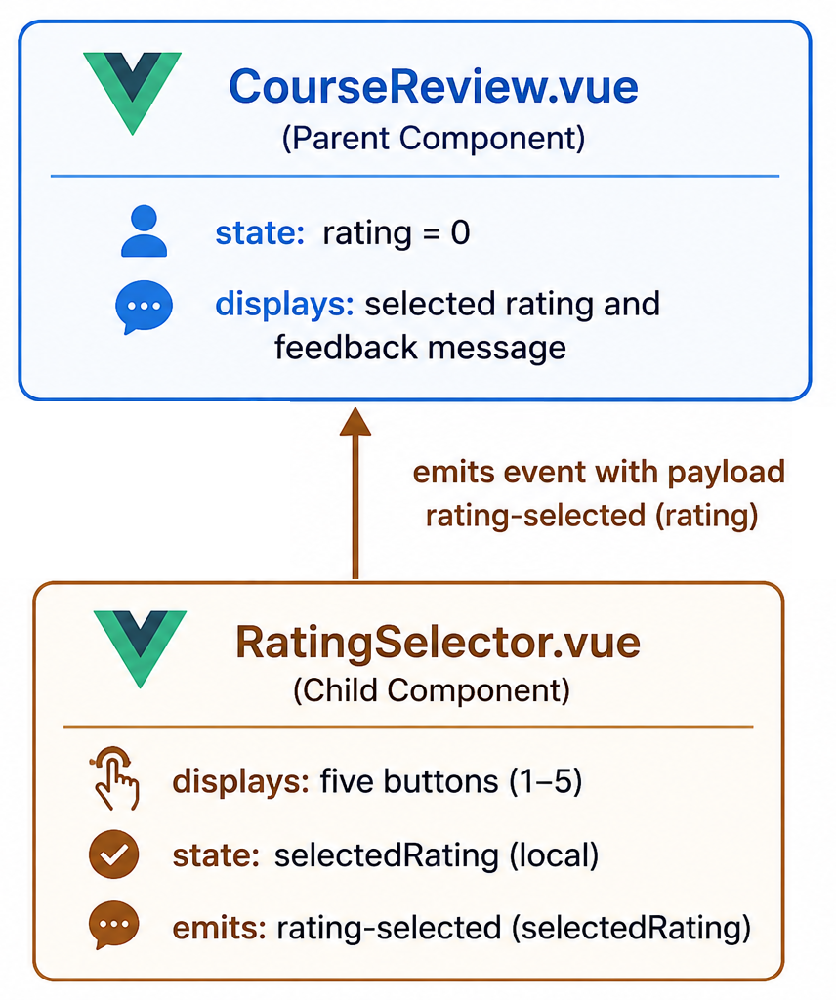
(HOMEWORK) Setting Up for Ex 2a
Component + Integration Test for Another Scenario
Setup:
Host Ex2a. This is a Vue app containing 2 components (CourseReview & RatingSelector)
In this lab, we will perform component tests on each individual component, followed by an integration test to ensure both components work together correctly.
Unlike the first example, the child component communicates by emiting a custom event which the parent component is listening to

Slide 25
Setting Up for Ex2a
Study the code for CourseReview and RatingSelector. RatingSelector emits a rating-selected event to notify CourseReview when the user clicks on a rating score.
Component | Responsibilities
CourseRevew | • Acts as the parent component. • Maintains the current course rating in its state (rating). • Receives rating updates from RatingSelector via the rating-selected custom event. • Updates its state through the updateRating() method. • Displays the user's selected rating. • Displays an appropriate feedback message (Thank you for your positive feedback/We will work to improve the course) based on selected rating. • Coordinates communication between itself & the child component.
RatingSelector | • Acts as the child component. • Displays five buttons (ratings 1-5) for user selection. • Maintains its own local selected rating. • Handles button click events through selectRating(). • Emits a rating-selected custom event to notify parent of the selected rating. • Displays immediate feedback (Excellent/Good/Poor) based on selected rating.
We will be testing the individual components first, followed by an integration test.

Slide 26
Ex2a: Component + Integration Test (1)
Component Test for RatingSelector
The test simply:
clicks the rating buttons,
verifies the displayed feedback,
verifies that the rating-selected event is emitted.
To Do:
Write the 3rd & 4th test in RatingSelector.spec.js.
Execute all 5 tests & ensure they pass
Test cases:
Test | Input | Expected Output | Purpose
(1) Renders five rating buttons | Renders five rating buttons | Five buttons are displayed | Verify that users are presented with five rating choices.
(2) Shows Poor when rating 1 is selected | Shows Poor when rating 1 is selected | Displays "Poor" | Verify that a low rating displays the correct feedback message.
(3) Shows Good when rating 3 is selected | hows Good when rating 3 is selected | Displays "Good" | Verify that a medium rating displays the correct feedback message
(4) Shows Excellent when rating 5 is selected | Shows Excellent when rating 5 is selected | Displays "Excellent!" | Verify that a high rating displays the correct feedback message.
(5) Emits the selected rating | Emits the selected rating | Emits rating-selected with payload 4 | Verify that component notifies its parent with the correct event & selected rating.

Slide 27
Ex2a(2)
Component Test for CourseReview Using Stubs (OPTIONAL)
To test CourseReview in isolation, we can use a stub to represent RatingSelector. The stub simulates a rating-selected event & we can check if CourseReview reacts correctly (i.e. updates the value of rating & display the correct message)
Test cases:
Test | Input | Expected Output | Purpose
(1) Shows rating 0 initially | Component is mounted | Displays "Your rating: 0" | Verify the component's initial state is correct.
(2) Shows positive feedback when rating is 4 | updateRating(4) is called | Displays "Thank you for your positive feedback!" | Verify that high ratings display the correct feedback message.
(3) Shows improvement feedback when rating is 2 | updateRating(2) is called | Displays "We will work to improve the course." | Verify that low ratings display the correct feedback message.
(4) Updates rating when RatingSelector emits rating-selected | Child component emits rating-selected with payload 5 | Displays "Your rating: 5" and "Thank you for your positive feedback!" | Verify that the parent correctly responds to the child's emitted event and updates its UI.

Slide 28
Ex2a(3)
Integration Test for Both Components
Read src/components/__tests__/IntegrationTest.spec.js. The tests here verify that RatingSelector and CourseReview work together correctly: when the user clicks on one of the numeric buttons in RatingSelector, CourseReview will display the correct message.
In your terminal window, run the tests in IntegrationTest.spec.js like this:
pnpm vitest IntegrationTest.spec.js
All 3 tests (1st, 2nd and 5th test) in IntegrationTest.spec.js should pass.
Write the 3rd and 4th test (see next slide). Run all 5 tests again and ensure they all pass.

Slide 29
Integration Test Test Cases:
Test | Input | Expected Output | Purpose
(1) Updates parent and shows positive feedback for rating 5 | User clicks the 5 button | Displays "Your rating: 5" and "Thank you for your positive feedback!" | Verify the complete interaction from user click → child emits event → parent updates state → DOM displays the correct rating and positive feedback.
(2) Updates parent and shows positive feedback for rating 4 | User clicks the 4 button | Displays "Your rating: 4" and "Thank you for your positive feedback!" | Verify that the parent correctly handles a rating of 4 and displays the positive feedback message.
(3) Updates parent and shows improvement feedback for rating 3 | User clicks the 3 button | Displays "Your rating: 3" and "We will work to improve the course." | Verify that the parent correctly handles a medium rating and displays the improvement feedback message.
(4) Updates parent and shows improvement feedback for rating 2 | User clicks the 2 button | Displays "Your rating: 2" and "We will work to improve the course." | Verify that the parent correctly handles a low rating and displays the improvement feedback message.
(5) Updates parent and shows improvement feedback for rating 1 | User clicks the 1 button | Displays "Your rating: 1" and "We will work to improve the course." | Verify that the parent correctly handles the lowest rating and displays the improvement feedback message.

Slide 30
Summary: Vue Test Utils Method
Method | Explanation
mount(…) e.g., wrapper = mount(StudentGrade) | Return a test wrapper around the component.
wrapper.text() e.g. expect(wrapper.text()).toContain(‘good’) | returns the combined text content of the component’s rendered DOM.
wrapper.findAll(selector) e.g. wrapper.findAll(‘button’) | finds multiple DOM elements matching a selector
wrapper.find(selector) e.g. wrapper.find('select').setValue('Euro’) wrapper.find('#user').setValue('Jack') | Returns the first matched DOM element
[element].trigger(…) e.g. await wrapper.findAll('button’)[0].trigger('click') | simulates a user interaction on a DOM element such as click event
wrapper.props() e.g. wrapper.props().msg | Returns the props of the Vue instance
wrapper.vm e.g., wrapper.vm.updateRating(4) | the actual Vue instance of the wrapped component, so you can access: data, methods, computed properties
await wrapper.vm.$nextTick() | waits until Vue has finished processing any pending DOM updates and reactive state changes before continuing.
wrapper.emitted(‘cust-event') | returns an array of all times that event was emitted
wrapper.emitted(‘cust-event')[0] | returns the event data by the first emitted event.

